Slide 1
National Economic Education Delegation
Vision
One day, the public discussion of policy issues will be grounded in an accurate perception of the underlying economic principles and data.
Mission
NEED unites the skills and knowledge of a vast network of professional economists to promote understanding of the economics of policy issues in the United States.
NEED Presentations
Are nonpartisan and intended to reflect the consensus of the economics profession.

Slide 2
Globalization: Its Rise and Perhaps Its Fall
Alan V. Deardorff
University of Michigan
NEED Webinar
April 24, 2020

Slide 3
Outline
What is Globalization?
Pros and Cons
Policies
Effects of the Pandemic
Globalization’s Future?

Slide 4
What Globalizations Is
Growth over time of many interactions between countries
Trade
Global Value Chains
Foreign Direct Investment
Financial Flows
Migration
International Travel

Slide 5
Trade

Slide 6
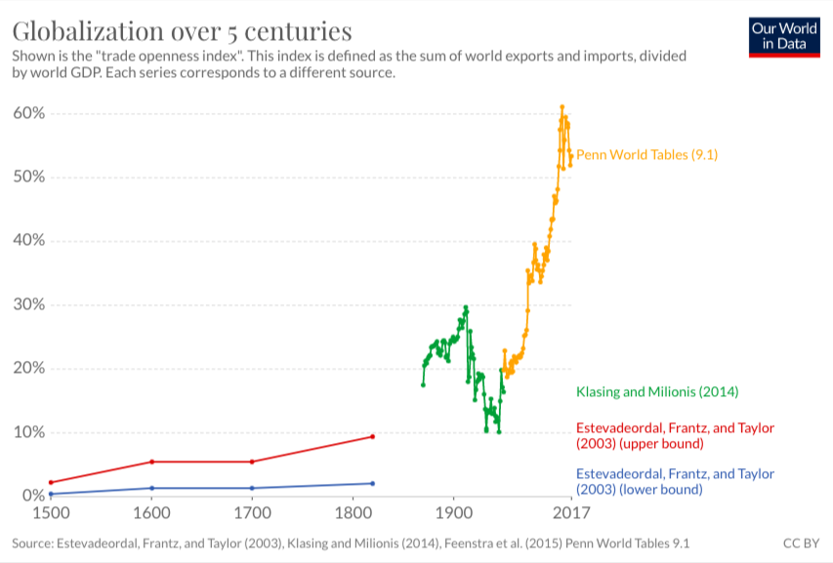
Notes:
Our World in Data
https://ourworldindata.org/trade-and-globalization

Slide 7
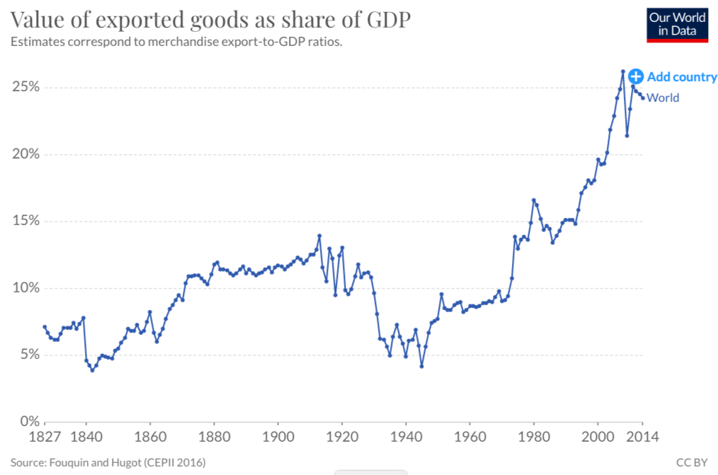
Notes:
Our World in Data
https://ourworldindata.org/trade-and-globalization

Slide 8
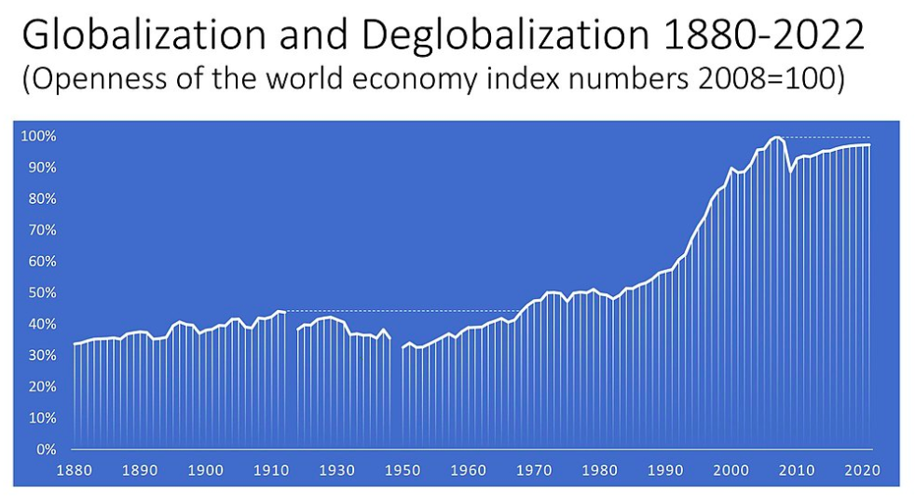
Source: Wikipedia
Notes:
Wikipedia
https://en.wikipedia.org/wiki/Deglobalization#/media/File:Openness_of_the_world_economy_1880-2020_(index_numbers_2008=100).jpg

Slide 9
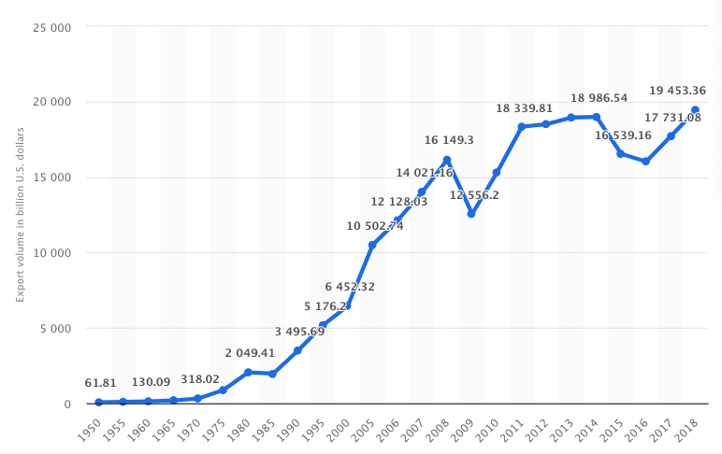
Export Volume Worldwide in Billions of US Dollars, 1950-2018
Source: Statista
Notes:
Statista
https://www.statista.com/statistics/264682/worldwide-export-volume-in-the-trade-since-1950/

Slide 10
Global Value Chains

Slide 11
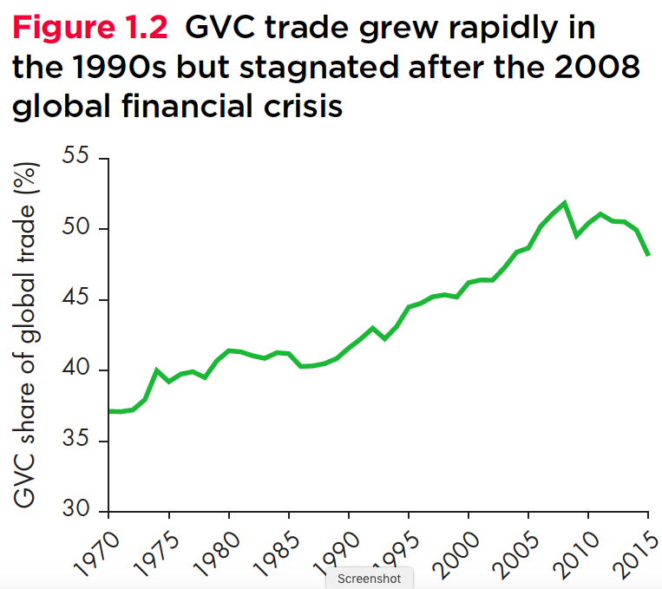
Growth of Global Value Chains, 1970-2015
Source: World Development Report 2020
Notes:
World Bank
https://www.worldbank.org/en/publication/wdr20

Slide 12
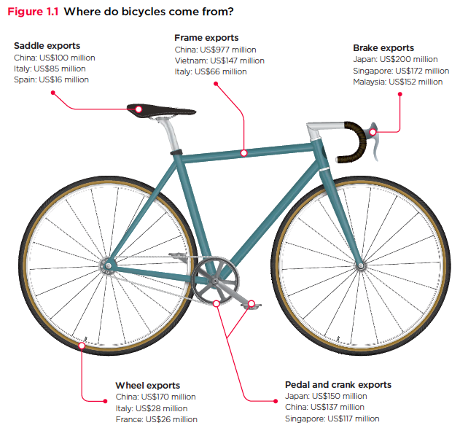
Source: World Development Report 2020
Notes:
World Bank
https://www.worldbank.org/en/publication/wdr20

Slide 13
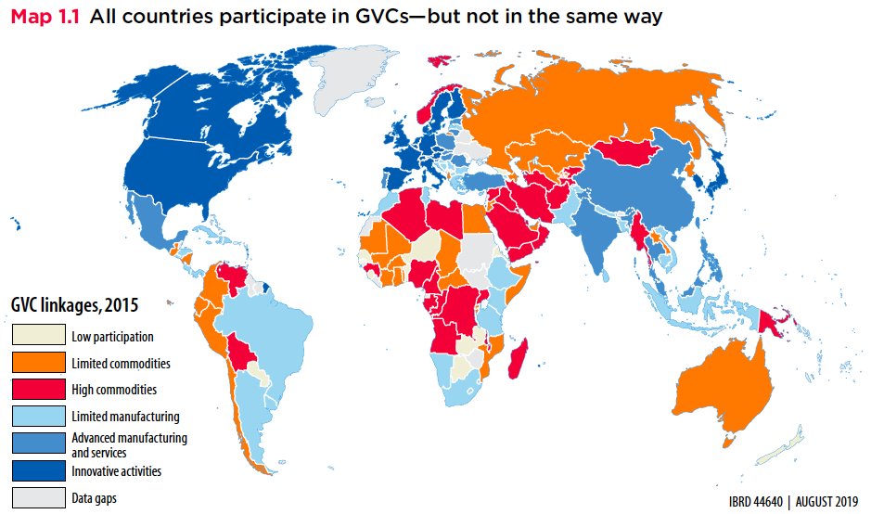
Export Volume Worldwide in Billions of US Dollars, 1950-2018
Source: World Development Report 2020
Notes:
World Bank
https://www.worldbank.org/en/publication/wdr2020

Slide 14
Foreign Direct Investment (i.e., multinational companies)

Slide 15
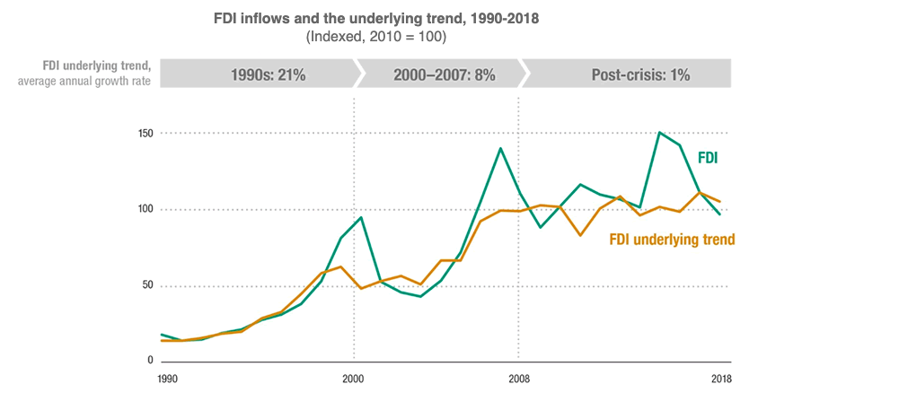
Source: UNCTAD
Notes:
United Nations Conference on Trade and Development
https://unctad.org/en/pages/newsdetails.aspx?OriginalVersionID=2118

Slide 16
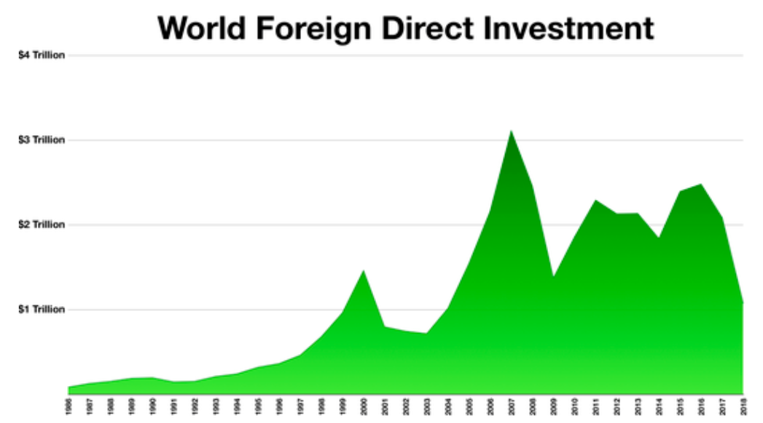
World Foreign Direct Investment, 1986-2016
Source: Wikipedia
Notes:
Wikipedia
https://en.wikipedia.org/wiki/Foreign_direct_investment

Slide 17
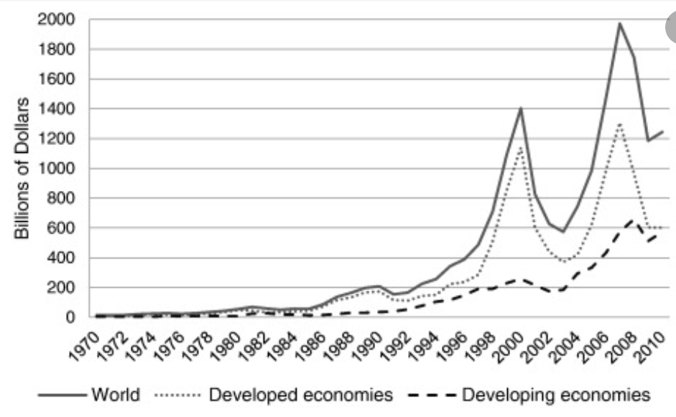
Foreign Direct Investment, 1970-2010
Source: ScienceDirect.com
Notes:
Iamsiraroj 12016
Science Direct.com
https://www.google.com/search?q=world+foreign+ownership&tbm=isch&ved=2ahUKEwiryZ_M3uDoAhUE3KwKHdxkC6gQ2-cCegQIABAA&oq=world+foreign+ownership&gs_lcp=CgNpbWcQAzoECAAQQzoCCAA6BggAEAgQHjoECAAQGFDl8w1Y2ZgOYLSoDmgAcAB4AIABSogB6wuSAQIyM5gBAKABAaoBC2d3cy13aXotaW1n&sclient=img&ei=_-iRXuvNK4S4swXcya3ACg&bih=687&biw=1387#imgrc=A4C0smrcRoOabM

Slide 18
Financial Flows

Slide 19
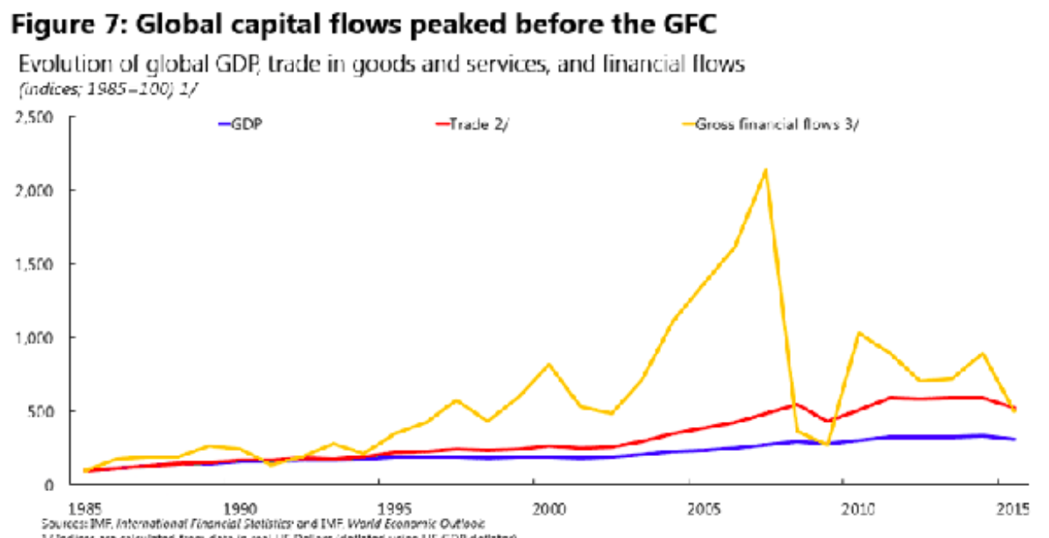
Source: Obstfeld 2017
Notes:
Obstfeld 2017
https://www.imf.org/en/News/Articles/2017/07/24/sp072417-two-trilemmas-for-monetary-policy

Slide 20
Migration

Slide 21
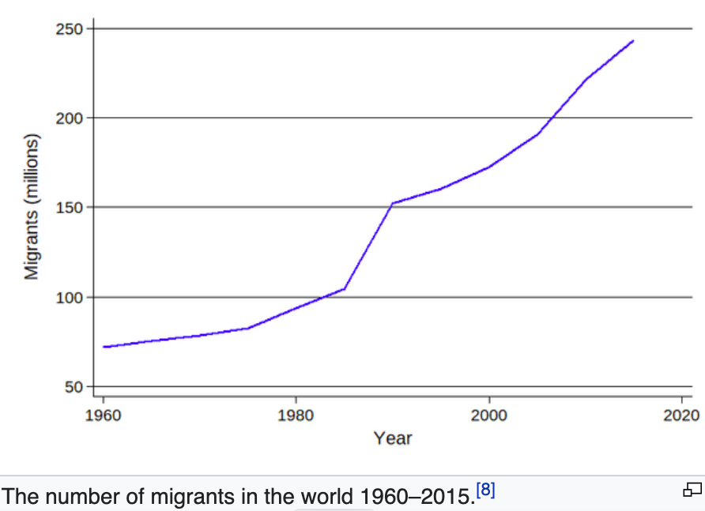
Source: Wikipedia
Notes:
Wikipedia
https://en.wikipedia.org/wiki/Human_migration

Slide 22
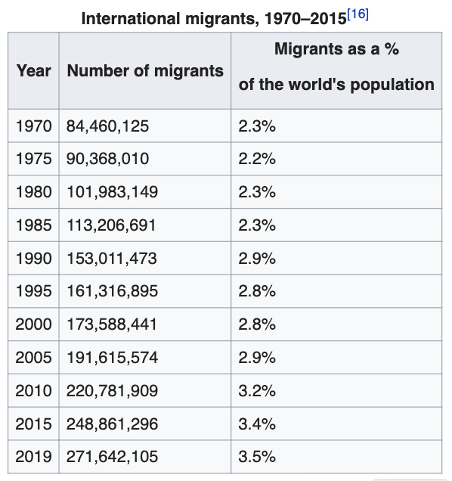
Source: Wikipedia
Notes:
Wikipedia
https://en.wikipedia.org/wiki/Human_migration

Slide 23
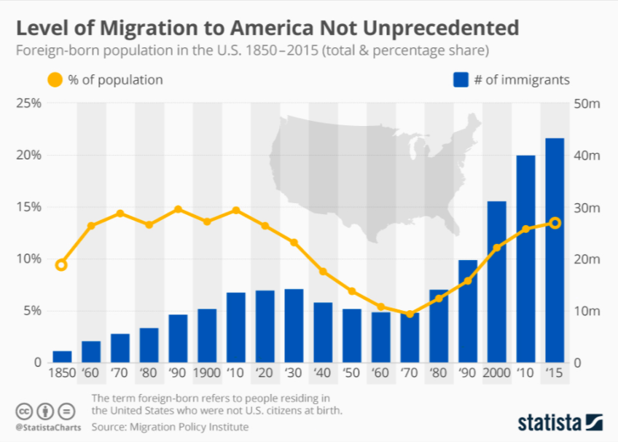
Source: Statista
Notes:
Statista
https://www.statista.com/chart/8083/immigrants-foreign-born-united-states/

Slide 24
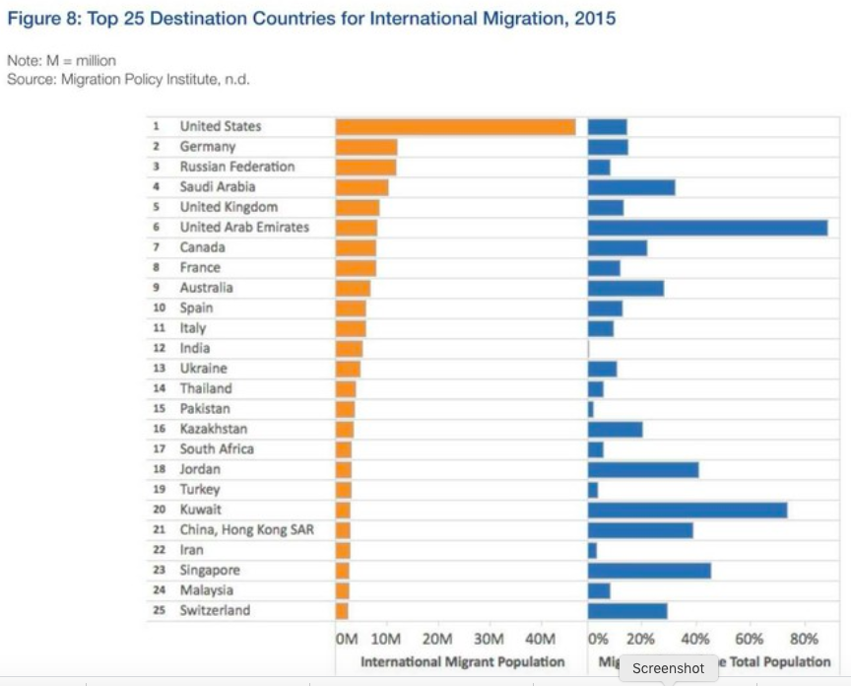
International Migrant Population
Migrants as Percent of Total Population
Source: Gray 2017
Notes:
Gray 2017
https://www.weforum.org/agenda/2017/10/how-migration-is-changing-world-cities-charts/

Slide 25
International Travel

Slide 26
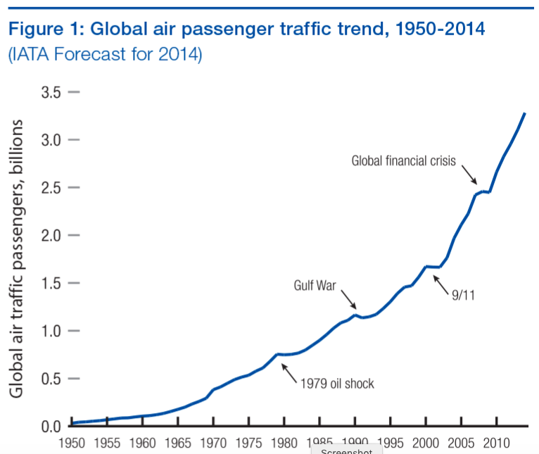
Source: Oxley and Jain 2015
Notes:
Oxley and Jain 2015
https://reports.weforum.org/travel-and-tourism-competitiveness-report-2015/chapter-1-4-global-air-passenger-markets-riding-out-periods-of-turbulence/

Slide 27
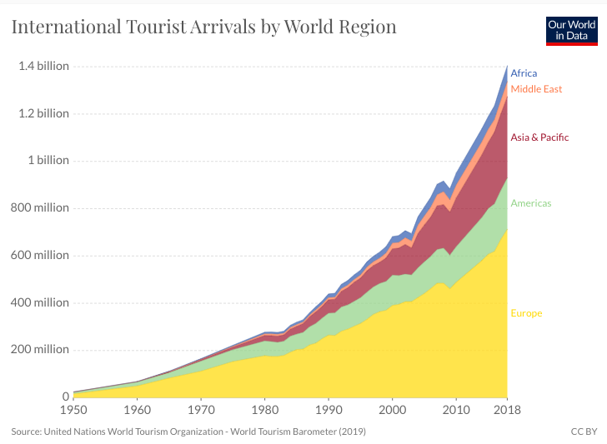
Notes:
Our World in Data
https://ourworldindata.org/tourism

Slide 28
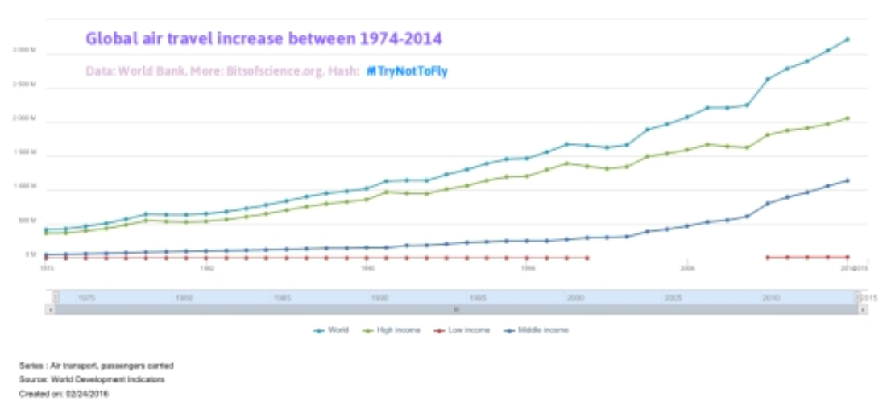
World
High Income Countries
Middle Income Countries
Low Income Countries
Source: Schuttenhelm 2016
Notes:
Schuttenhelm 2016
http://www.bitsofscience.org/graph-global-air-travel-increase-6848/

Slide 29
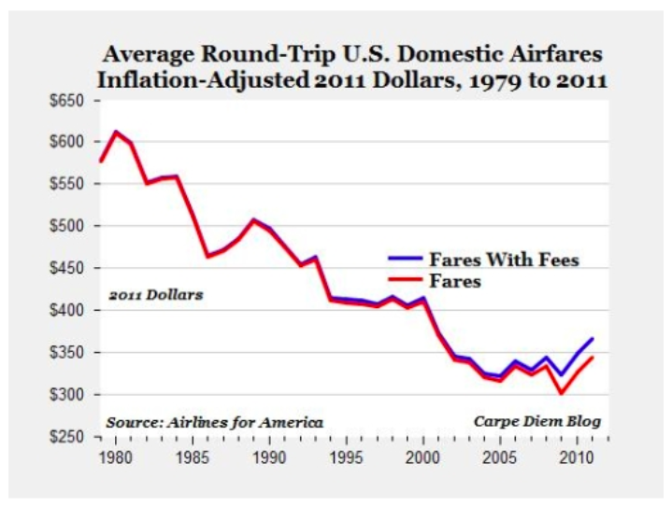
Source: Schuttenhelm 2016
Notes:
Schuttenhelm 2016
http://www.bitsofscience.org/graph-global-air-travel-increase-6848/

Slide 30
Pros and Cons of Globalization
Pros and Cons of Globalization
Gains from Trade
Theory of Comparative Advantage
Other Sources of Gain from Trade
Costs of Trade

Slide 31
Gains from Trade Theory of Comparative Advantage

Slide 32
Comparative Advantage
If US & UK differ in what they can produce…
Cloth
US
Cloth
UK
Food
Food

Slide 33
Comparative Advantage
… Without trade, their consumption will also differ…
Cloth
US
Cloth
UK
Without trade
Consumption =
Production
C^{B}=P^{B}
C^{A}=P^{A}
Food
Food

Slide 34
Comparative Advantage
… With free trade, they specialize in what they do best…
Cloth
US
Cloth
UK
P^{B}
Free Trade
Production
C^{B}=P^{B}
C^{A}=P^{A}
P^{A}
Food
Food

Slide 35
Comparative Advantage
… And can consume more by trading.
Cloth
US
Cloth
UK
P^{B}
Trade
Free Trade
Consumption
C^{B}
C^{A}
C^{B}=P^{B}
Trade
C^{A}=P^{A}
P^{A}
Food
Food

Slide 36
Comparative Advantage
Thus countries both Gain from Trade
Cloth
US
Cloth
UK
P^{B}
Trade
Gain from Trade
C^{A}
C^{B}=P^{B}
Trade
C^{A}=P^{A}
P^{A}
Food
Food

Slide 37
Gains from Trade Other Sources of Gain from Trade

Slide 38
Other sources of Gain from Trade
Productivity (most productive firms expand and export)
Returns to scale (small countries can support larger firms)
Competition (monopolies in small countries lose market power)
Variety (buyers can access more choices)
Supply chains (firms source parts from cheapest sources)
Technology (producers access foreign technologies)

Slide 39
Costs of Trade

Slide 40
But there are Costs
Economic:
When trade expands (or contracts)
Some firms lose market share or shut down
Their workers lose jobs
Their communities lose customers
Vulnerability to foreign recession/inflation
Non-economic
Dependence on other countries
Vulnerability to trade disruption
Crisis induced (earthquake, flood, disease)
Policy induced (sanctions, tariffs, export bans)

Slide 41
Policies that Affect Globalization
Policies that Affect Globalization
That Encourage It
Tariff Reductions
Trade Agreements
Other
That Discourage It
Trump’s Tariffs
Trade War

Slide 42
Policies that Encourage Globalization

Slide 43
Tariff Reductions

Slide 44
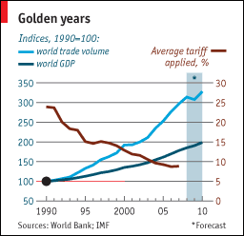
Source: Economist
Notes:
From an Economist “Barriers to Entry” article

Slide 45
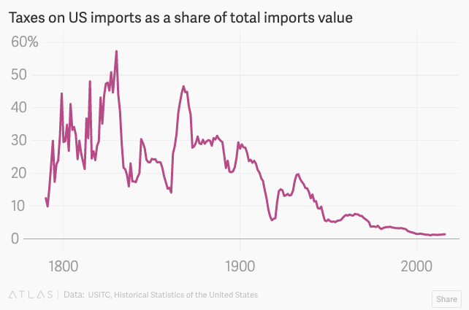
Source: Quartz 2018
Notes:
Quartz, Kopf 2018
https://qz.com/1230399/a-history-of-tariffs-us-protectionism-in-one-230-year-chart/

Slide 46
Trade Agreements

Slide 47
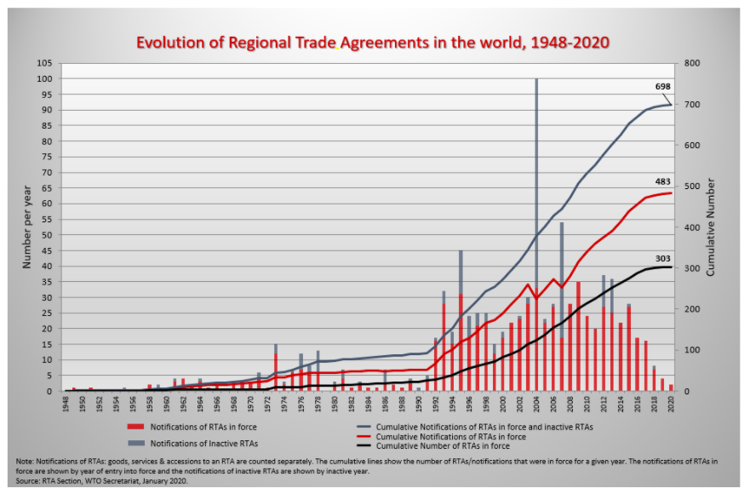
Source: WTO
Notes:
WTO
https://www.wto.org/english/tratop_e/region_e/region_e.htm#facts

Slide 48
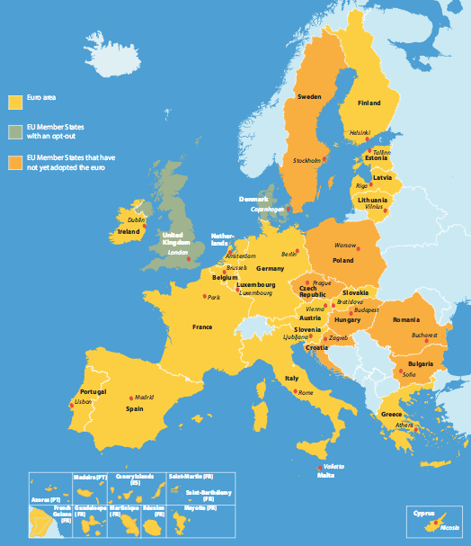
European Union
Source: Europa.eu
Notes:
http://europa.eu/european-union/about-eu/money/euro_en

Slide 49
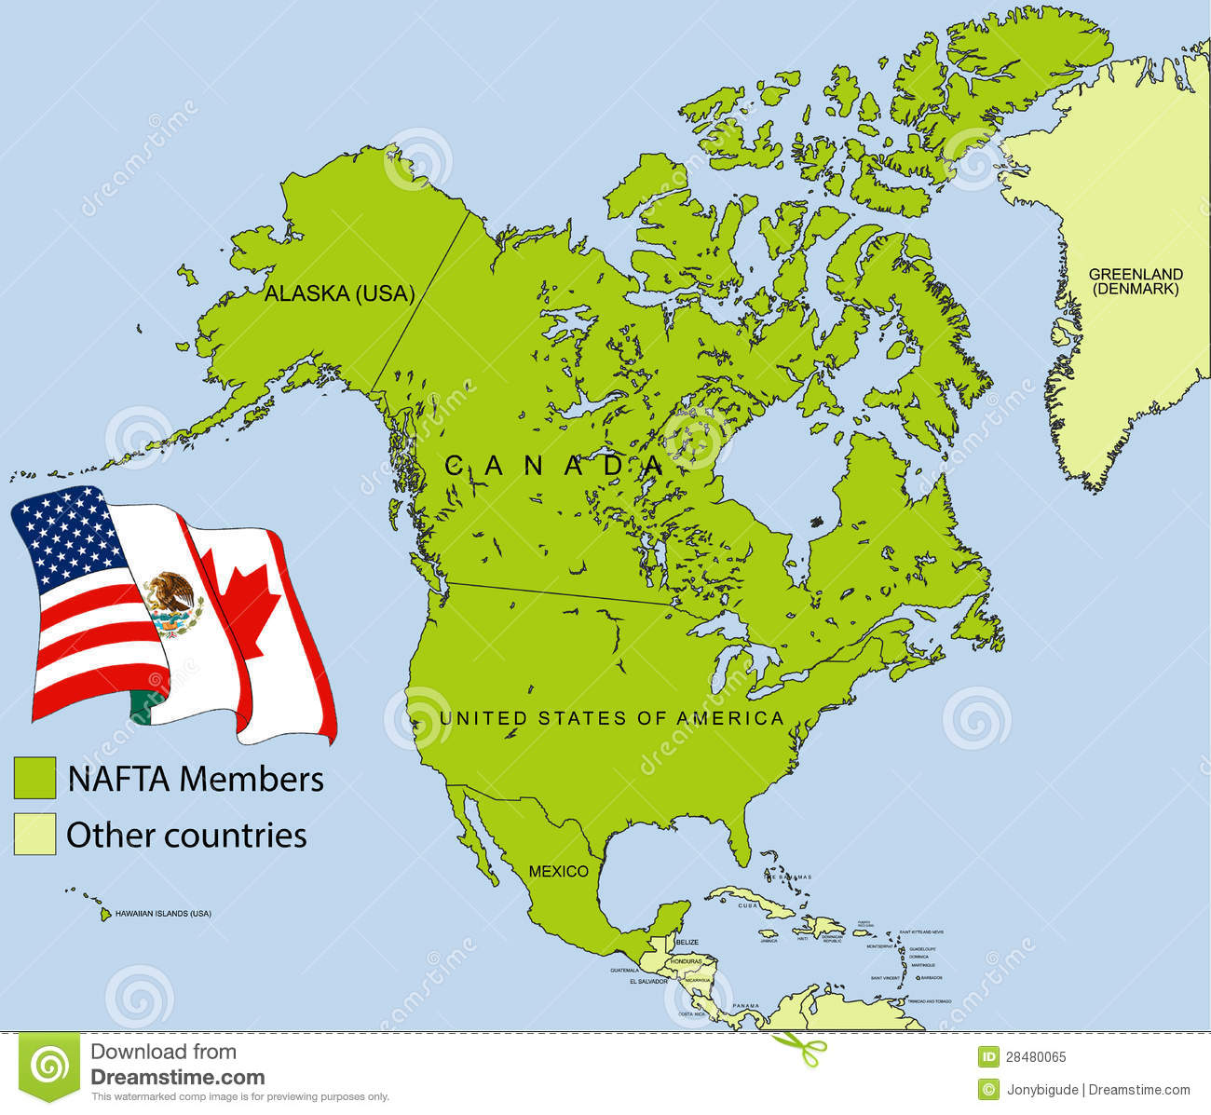
NAFTA (now USMCA)

Slide 50
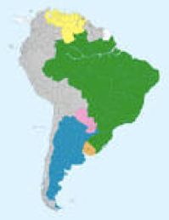
MERCOSUR

Slide 51
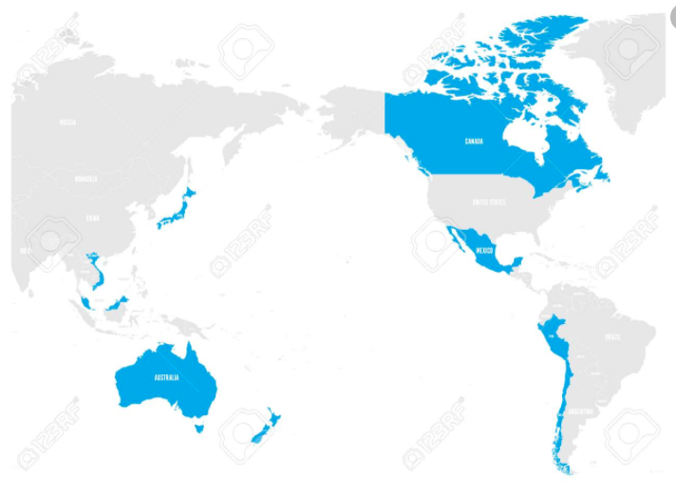
CPTPP = Trans-Pacific Partnership minus US

Slide 52
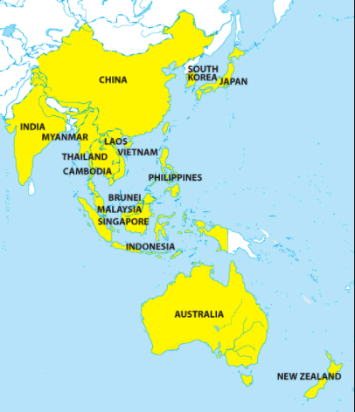
RCEP = Regional Comprehensive Economic Partnership (Pending, hope to sign by end of 2020)
Notes:
China Briefing 2012
https://www.china-briefing.com/news/china-to-join-rcep-creating-massive-free-trade-area-with-asean-india-and-japan/

Slide 53
Other Policies to Encourage Globalization
IMF/World Bank
Policy advice to open markets (the ”Washington Consensus”)
Loans to countries conditional on
Reducing trade barriers
Permitting capital flows
GATT/WTO (World Trade Organization)
Negotiate reciprocal trade liberalization
Settlement of trade disputes (usually about interfering with trade)
Bilateral Investment Treaties
Better treatment of multinational corporations

Slide 54
Policies that Discourage Globalization

Slide 55
Trump’s Tariffs

Slide 56
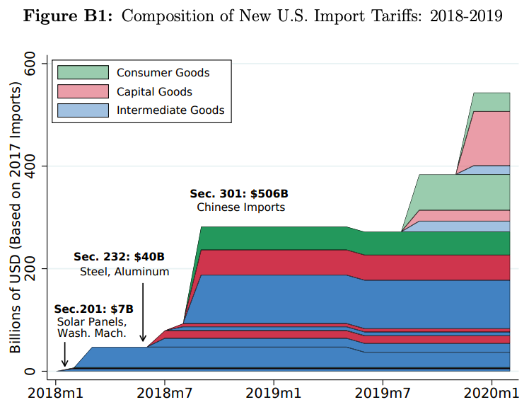
Source: Flaan & Pierce 2020
Notes:
Flaan and Pierce 2020
https://www.federalreserve.gov/econres/feds/files/2019086pap.pdf

Slide 57
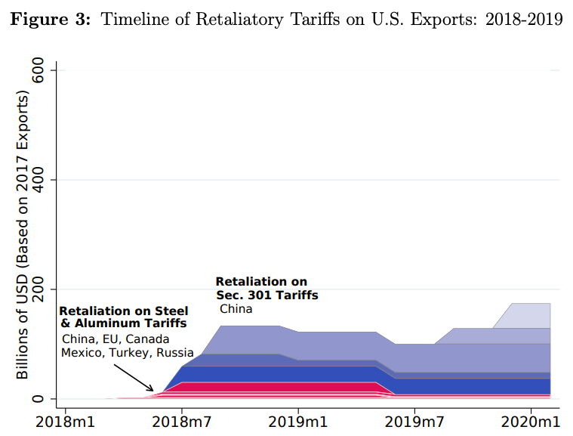
Source: Flaan & Pierce 2020
Notes:
Flaan and Pierce 2020
https://www.federalreserve.gov/econres/feds/files/2019086pap.pdf

Slide 58
Trade War

Slide 59
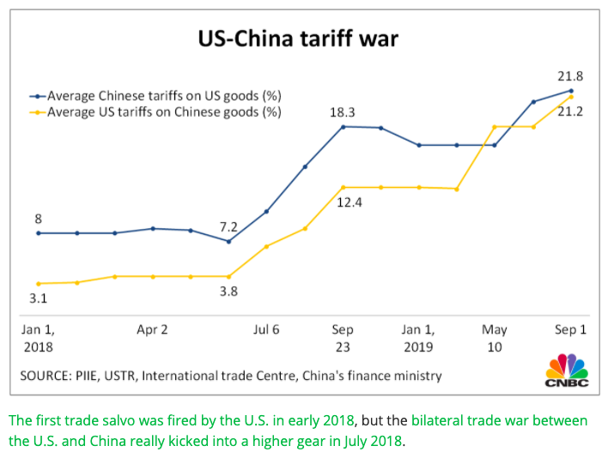
Source: CNBC.com
Notes:
SEPTEMBER 18, 2019 | Yen Nee Lee, CNBC.com
http://nbr.com/2019/09/18/these-4-charts-show-how-us-china-trade-has-changed-during-the-tariff-dispute/

Slide 60
Other Policies to Discourage Globalization
Undermine the WTO
Trump blocks appointments at WTO, disabling the Dispute Settlement Body
Export bans
To keep food cheap at home
To keep medical supplies at home
Immigration restrictions
Trump blocks travelers from target countries
US and others block refugees

Slide 61
Effects of the Pandemic on Globalization
Effects of the Pandemic on Economies
Travel halted
Stock markets fall
Factories shut down
Supply chains interrupted
Trade plummets
Unemployment
Reduced GDP
Panic buying and shortages

Slide 62
Travel

Slide 63
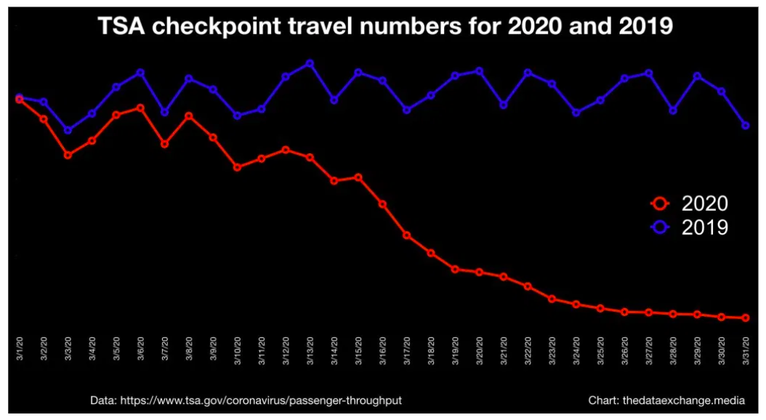
(MARCH)
Source: Lorica April 1, 2020 The Data Exchange
Notes:
Lorica April 1, 2020 The Data Exchange
https://thedataexchange.media/one-simple-chart-air-travel-in-the-us

Slide 64
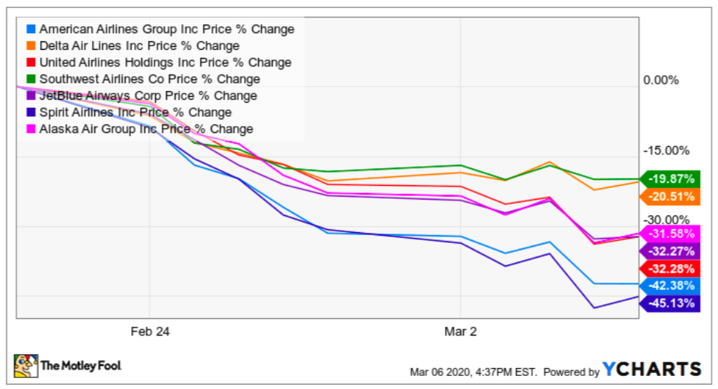
Airline Stock Prices
Notes:
The Motley Fool
https://www.fool.com/investing/2020/03/08/should-you-buy-or-sell-airline-stocks-right-now.aspx

Slide 65
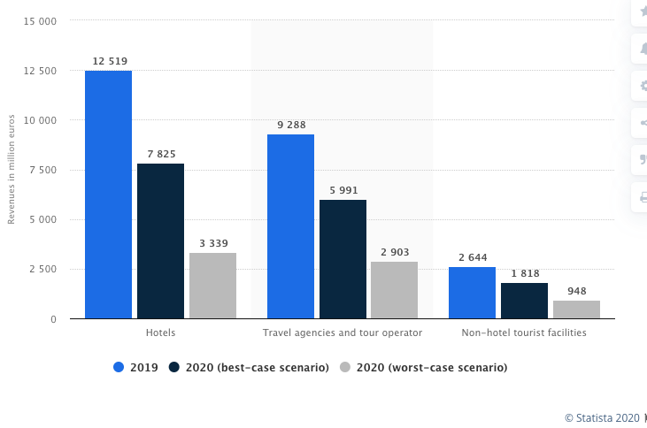
Estimated impact of coronavirus (COVID-19) on revenues of the tourism industry in Italy in 2020, by sector
Source: Statista
Notes:
Statista
https://www.statista.com/statistics/1105157/impact-of-coronavirus-covid-19-on-tourism-revenues-in-italy-by-sector/

Slide 66
Stock Markets

Slide 67
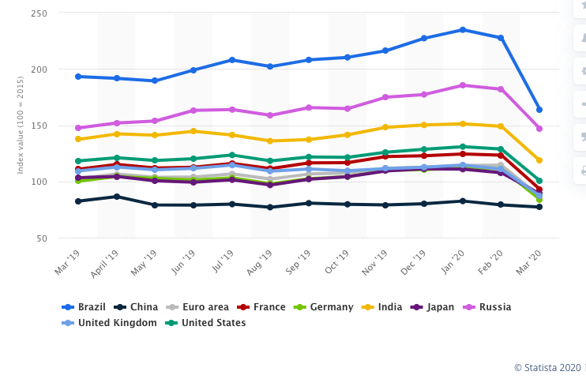
Share price index in major developed and emerging economies from March 2019 to March 2020
US
Source: Statista
Notes:
Statista
https://www.statista.com/statistics/1034575/share-price-index-in-major-developed-and-emerging-economies/

Slide 68
Factory Shut-downs

Slide 69
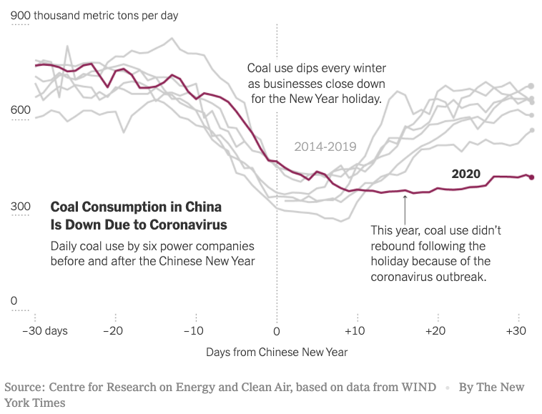
Source: Plumer et al. Mar 6, 2020, NYT
Notes:
Plumer et al. Mar 6, 2020, NYT
https://www.nytimes.com/2020/02/26/climate/nyt-climate-newsletter-coronavirus.html

Slide 70
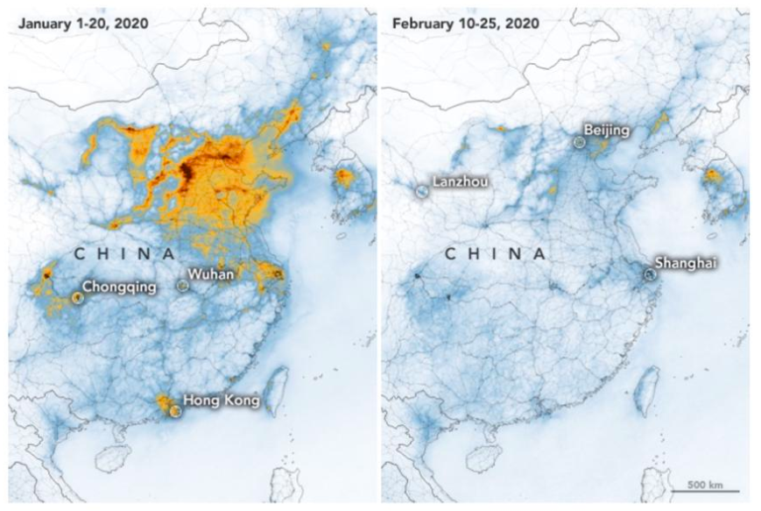
Pollution before vs after Coronavirus quarantine.
NASA
Notes:
NASA, Forbes
https://www.forbes.com/sites/trevornace/2020/03/03/coronavirus-nasa-reveals-how-cinas-lockdown-drastically-reduced-pollution/#398e493f2a75

Slide 71
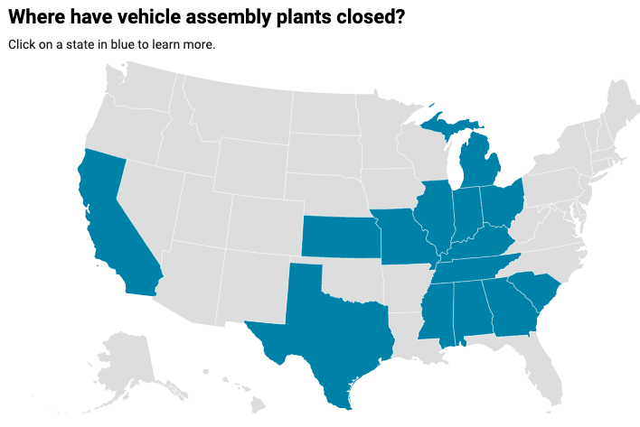
Plans to restart
As of Apr 22:
Ford: None
GM: None
FCA: sometime after May 3
Others: See map
5/4
5/11
5/4
5/4
5/4
5/3
4/27
5/11
4/27
5/4
5/4
4/13
5/4
Source: Automotive News, March 25, 2020
Notes:
Automotive News, March 25, 2020
https://www.autonews.com/manufacturing/follow-latest-assembly-plant-closings

Slide 72
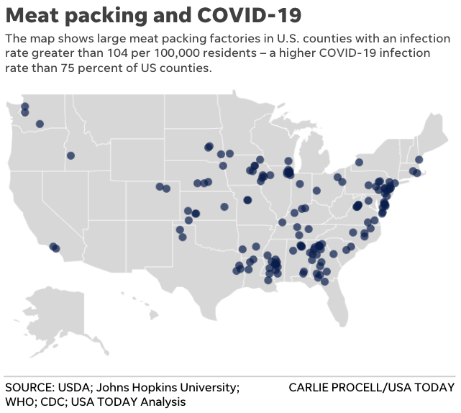
Source: USA Today
Apr 22
Notes:
Bagenstose et al., “Coronavirus at meatpacking plants worse than first thought, USA TODAY investigation finds,” USA Today, Apr 22, 2020.
https://www.usatoday.com/in-depth/news/investigations/2020/04/22/meat-packing-plants-covid-may-force-choice-worker-health-food/2995232001/

Slide 73
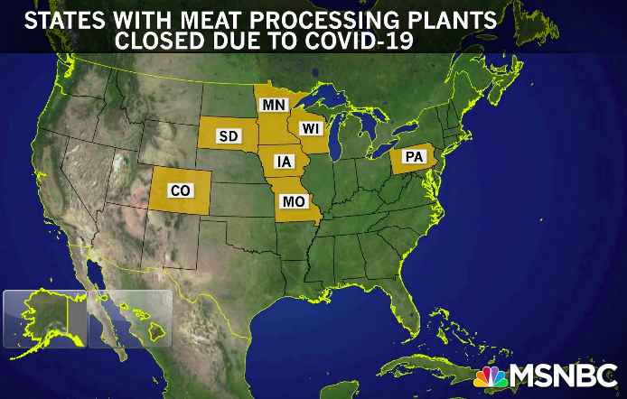
Source: MSNBC
Apr 20
Notes:
Rachel Madow Show, MSNBC, Apr 20, 2020
https://www.msnbc.com/rachel-maddow/watch/meat-processing-plants-prove-particularly-vulnerable-to-coronavirus-82318405836

Slide 74
Supply Chains

Slide 75
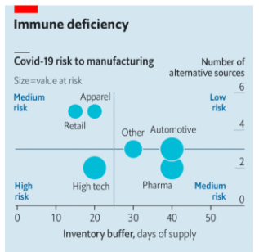
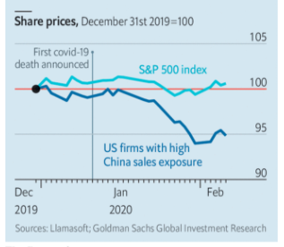
The new coronavirus could have a lasting impact on global supply chains
Source: Economist
Notes:
Economist Feb 15, 2020
https://www.economist.com/international/2020/02/15/the-new-coronavirus-could-have-a-lasting-impact-on-global-supply-chains

Slide 76
Trade

Slide 77
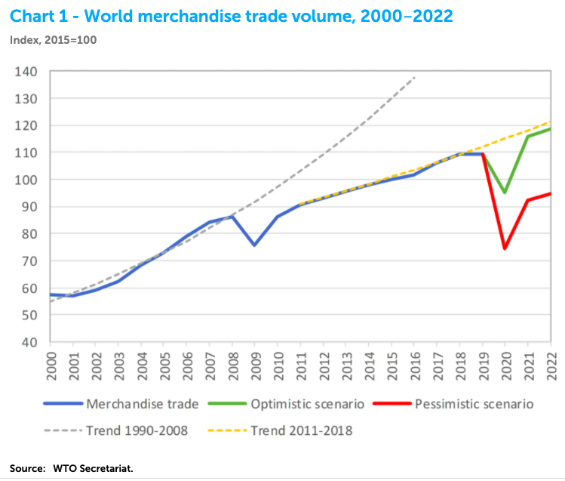

Slide 78
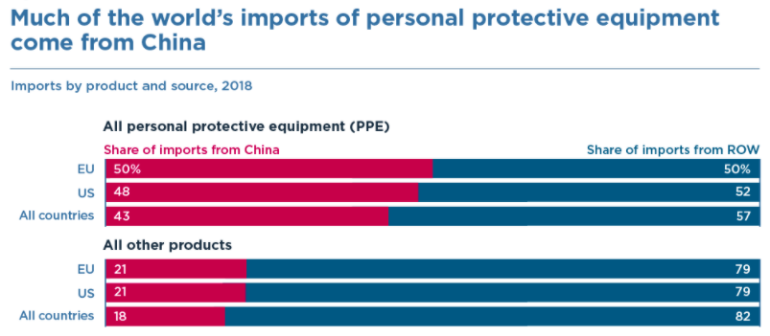
Source: Bown (2020)
Notes:
Bown (2020), “COVID-19: China's exports of medical supplies provide a ray of hope,” PIIE
https://www.piie.com/blogs/trade-and-investment-policy-watch/covid-19-chinas-exports-medical-supplies-provide-ray-hope

Slide 79
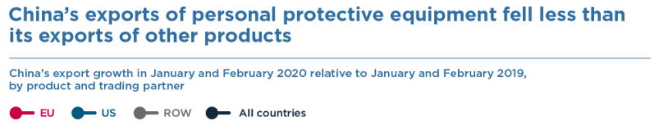
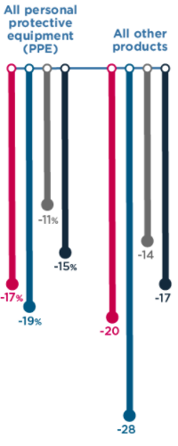
Source: Bown (2020)
Notes:
Bown (2020), “COVID-19: China's exports of medical supplies provide a ray of hope,” PIIE
https://www.piie.com/blogs/trade-and-investment-policy-watch/covid-19-chinas-exports-medical-supplies-provide-ray-hope

Slide 80
Unemployment

Slide 81
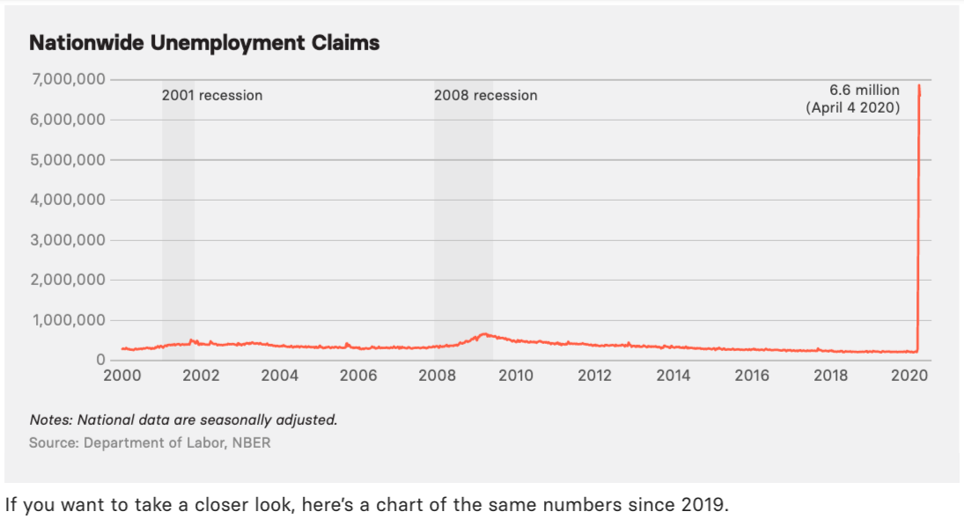
Source: Buzzfeed
Notes:
BuzzFeed News
https://www.buzzfeednews.com/article/lamvo/coronavirus-update-charts-unemployment-claims-laid-off-jobs

Slide 82
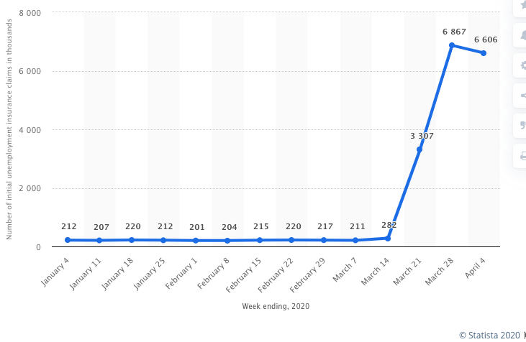
Number of Initial Unemployment Insurance Claims, thousands
Source: Statista
Notes:
Statista
https://www.statista.com/statistics/1107247/unemployment-insurance-initial-claims-weekly/

Slide 83
GDP

Slide 84
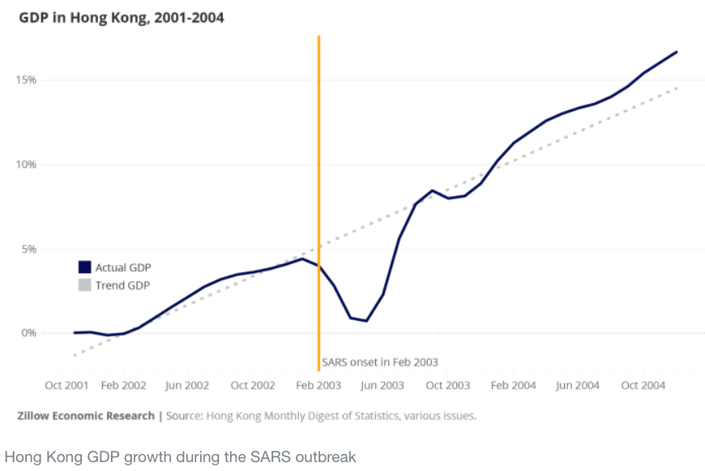
SARS Epidemic, Hong Kong: GDP 2001-2004
Source: Gudell 2020
Notes:
Gudell 2020
https://finance.yahoo.com/news/information-past-pandemics-learn-literature-222750122.html

Slide 85
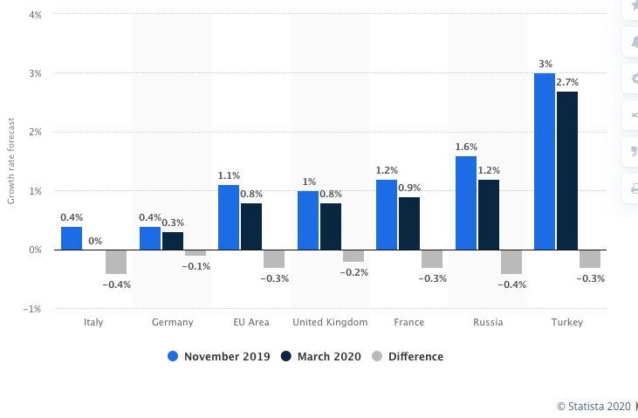
Real gross domestic product growth rate forecasts for selected European countries in 2020, by month of forecast
Source: Statista
Notes:
Statista
https://www.statista.com/statistics/1102546/coronavirus-european-gdp-growth/

Slide 86
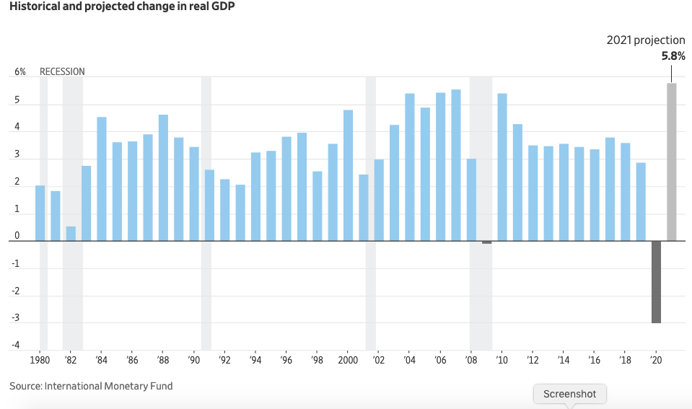
Historical and projected change in world real GDP
Source: WSJ Apr 15, 2020
Notes:
Zumbrun, WSJ Apr 15, 2020
https://www.wsj.com/articles/coronavirus-afflicted-global-economy-is-almost-certainly-in-recession-11586867402

Slide 87
Shortages

Slide 88

Source: Thurston, Mar 30. 2020
Notes:
Thurston, Mar 30. 2020 BUToday
https://www.bu.edu/articles/2020/will-coronavirus-lead-to-food-shortages-supply-chain-expert/

Slide 89

Source: Johnson Apr 8. 2020 grist
Notes:
Johnson Apr 8. 2020 grist
https://grist.org/food/coronavirus-myth-busting-the-truth-about-empty-shelves-and-toilet-paper-shortages/

Slide 90
Effects of the Pandemic on Globalization
Effects of the Pandemic on Policies
Travel restrictions
Export bans
Requests for reduced tariffs

Slide 91
Travel Restrictions

Slide 92

Source: Wikipedia
Notes:
Wikipedia
https://en.wikipedia.org/wiki/Travel_restrictions_related_to_the_2019%E2%80%9320_coronavirus_pandemic

Slide 93
Headlines on Travel restrictions
Jan 31, NYT: Trump Administration Restricts Entry Into U.S. From China
Mar 10, NYT: U.S. to Suspend Most Travel From Europe

Slide 94
Export Bans

Slide 95

Source: ITC
Notes:
ITC Market Access Map
https://www.macmap.org/covid19

Slide 96
Headlines on Export bans
Mar 19: Sickening thy neighbour: Export restraints on medical supplies during a pandemic
Apr 3, NYT: Trade Restrictions on Food Exports Due to the Coronavirus Pandemic
Apr 8, WP: As borders harden during pandemic, some countries look to hold on to their own food
Apr 8, WSJ: U.S. to Restrict Mask, Glove Exports for Four Months During Coronavirus Pandemic
Apr 10, Bloomberg: Food Supply Fears Are Growing as Romania Bans Grain Exports

Slide 97
Reduced Tariffs (?)

Slide 98
Headlines on Reduced Tariffs (?)
Mar 16 NYT: U.S. Weighs Tariff Relief but Some Fear China Will Take Advantage
Mar 19 WSJ: Trump Spurns Business Plea to Ease Tariffs Amid Coronavirus
Mar 24 FT: Drop the tariffs and save some lives. Quick
Mar 26 WSJ: U.S. Will Approve Some Delays in Tariff Payments Amid Coronavirus Crisis
Mar 31 FT: Trump to suspend some tariffs for 90 days
Apr 2 NYT: Trump Rebuffs Demands to Lift Tariffs as Economy Falters
Apr 13 WSJ: U.S. Tariffs Hamper Imports of Sanitizer, Disinfectants, Some Companies Say
Apr 20 FT: Trump exempts virus-hit US businesses from import tariffs

Slide 99
Globalization’s Future?

Slide 100
Globalization’s Future?
Will trade, travel, etc. come back?
Yes, partly
Will it reach the previous trend
Probably not.
It didn’t after the financial crisis
Will attitudes change?
Yes.
Firm’s will try to limit exposure
Consumers will learn to live differently
Will economists’ view of globalization change?
I think so.
We still think globalization is good, but it should include greater protections

Slide 101
Thank you!
Any Questions?
Alan V. Deardorff
Ford School of Public Policy
University of Michigan
www.NEEDelegation.org

